Slide 1


AIL 411-DEEP LEARNING LAB
PREPARED BY: ASHA ROSE THOMAS
AP,CSE(AI),ASIET,KALADY

Slide 2
EXPERIMENT 8
Analyse and visualize the performance change while using LSTM and GRU instead of simple RNN.

Slide 3
Issues with Standard RNN Cells
Problem: Standard RNN cells struggle with long-term dependencies.
Why?:
  Vanishing Gradient: Gradients become too small, hindering learning.
  Exploding Gradient: Gradients become too large, causing instability.
Need for Advanced Architectures
  Solution: Use LSTM (Long Short-Term Memory) and GRU (Gated Recurrent Unit) cells.
  How They Help:
    LSTM: Uses gates to manage information flow, retaining long-term dependencies.
    GRU: Similar to LSTM but simpler, effectively handling long-term dependencies.

Slide 4
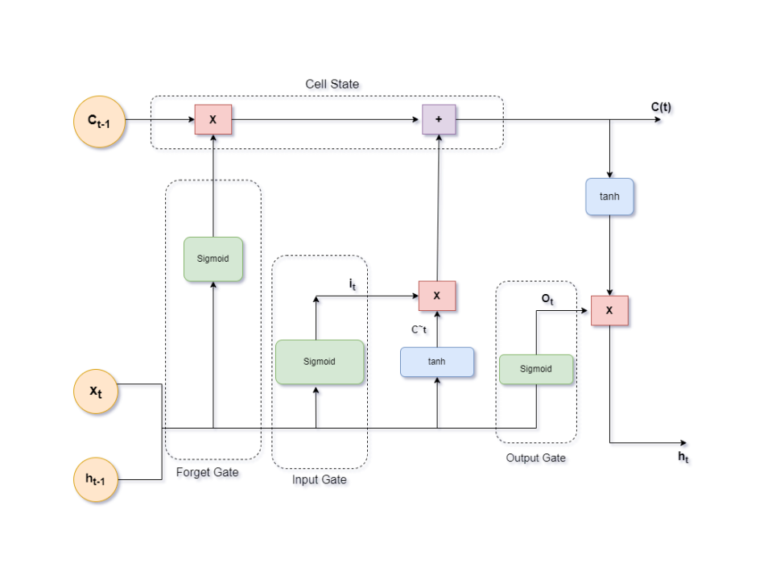
Long Short-Term Memory (LSTM)
Handles:
  Long Term Memory (LTM)
  Short Term Memory (STM)
Gates:
  To simplify and optimize calculations, it uses gates.
  Forget Gate: Decides what information to discard.
  Input Gate: Determines what new information to add.
  Output Gate: Controls the output based on the cell state.
Cell State
  Maintains long-term memory by carrying information across the sequence.
  Process:
    Combines the previous cell state with the new information.
    Uses the forget gate to remove irrelevant information.
    Uses the input gate to add relevant new information.
Notes:
Intuitive Explanation of an LSTM Cell
Imagine you are trying to remember a story that someone is telling you. As the story progresses, you need to remember important details from earlier in the story while also paying attention to new information. This is similar to how an LSTM cell works.
Key Components of an LSTM Cell
Cell State:
Analogy: Think of the cell state as a conveyor belt running through the entire story. It carries important details from the beginning to the end without much change.
Function: This conveyor belt helps maintain important information over long periods.
Gates:
Input Gate:
Analogy: Imagine you have a filter that decides what new information from the story should be added to your memory.
Function: Controls how much new information is added to the cell state.
Forget Gate:
Analogy: You also have a filter that decides what old information is no longer relevant and can be forgotten.
Function: Decides what information to discard from the cell state.
Output Gate:
Analogy: Finally, you have a filter that decides what information from your memory should be used to understand the next part of the story.
Function: Determines the output based on the cell state and the current input.
How It Works Together
Maintaining Important Information:
The cell state (conveyor belt) carries important details throughout the story, ensuring that crucial information is not lost over time.
Selective Memory:
The input gate filter allows only relevant new information to be added to your memory.
The forget gate filter removes unnecessary old information, keeping your memory efficient.
The output gate filter ensures that only the most relevant information is used to understand the next part of the story.
Example
Imagine you are reading a mystery novel. The LSTM cell helps you remember key clues from earlier chapters (cell state), decide which new clues are important to remember (input gate), forget irrelevant details (forget gate), and use the most relevant clues to solve the mystery as you read further (output gate).
By using these gates, the LSTM cell effectively manages long-term dependencies and ensures that important information is retained and used appropriately, making it much better at handling long sequences compared to standard RNN cells.

Slide 5
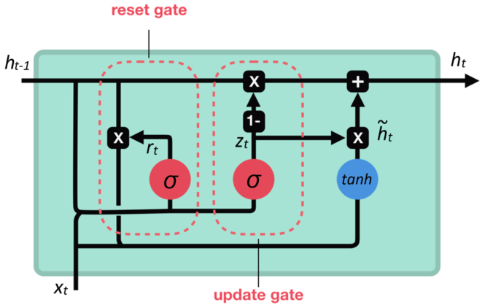
Gated Recurrent Unit(GRU) Cell
Reset Gate
  Controls how much past information to forget.
Update Gate
  Decides how much new information to add and what old information to keep.
How It Works Together
  Filtering Old Information: Reset gate helps forget irrelevant past information.
  Updating Memory: Update gate adds new information while keeping important past details.
Notes:
Intuitive Explanation of a GRU Cell
Imagine you are trying to remember a story, but you want to keep it simple and efficient. You don’t want to remember every single detail, just the important parts that help you understand the story as it unfolds. This is similar to how a Gated Recurrent Unit (GRU) cell works.
Key Components of a GRU Cell
Reset Gate:
Analogy: Think of the reset gate as a filter that decides how much of the past information you want to forget.
Function: It controls how much of the previous hidden state (memory) should be ignored when processing new information.
Update Gate:
Analogy: Imagine the update gate as a filter that decides how much of the new information should be added to your memory.
Function: It determines how much of the new information should replace the old information in the hidden state.
How It Works Together
Filtering Old Information:
The reset gate helps you decide which parts of the past information are no longer relevant and can be forgotten. This keeps your memory efficient and focused on the most important details.
Updating Memory:
The update gate allows you to add new, relevant information to your memory while retaining important past information. This ensures that your memory is always up-to-date with the most crucial details.
Example
Imagine you are reading a mystery novel. The GRU cell helps you remember key clues from earlier chapters (reset gate), decide which new clues are important to remember (update gate), and use the most relevant clues to solve the mystery as you read further.
Reset Gate: If a clue from Chapter 1 is no longer relevant, the reset gate helps you forget it.
Update Gate: When you find a new clue in Chapter 5, the update gate helps you add this new clue to your memory, ensuring you don’t forget the important clues from earlier chapters.
By using these gates, the GRU cell effectively manages the flow of information, making it simpler and faster than other models like LSTM, while still being able to handle long-term dependencies.

Slide 6
Reference

